Slide 1
The Business Model Canvas
Prof. Dr. Dirk Riehle
Friedrich-Alexander University Erlangen-Nürnberg
COSS A03
Licensed under CC BY 4.0 International
Notes:
It is Friedrich-Alexander University Erlangen-Nürnberg – FAU, in short.
Corporate identity wants us to say “Friedrich-Alexander University”.

Slide 2
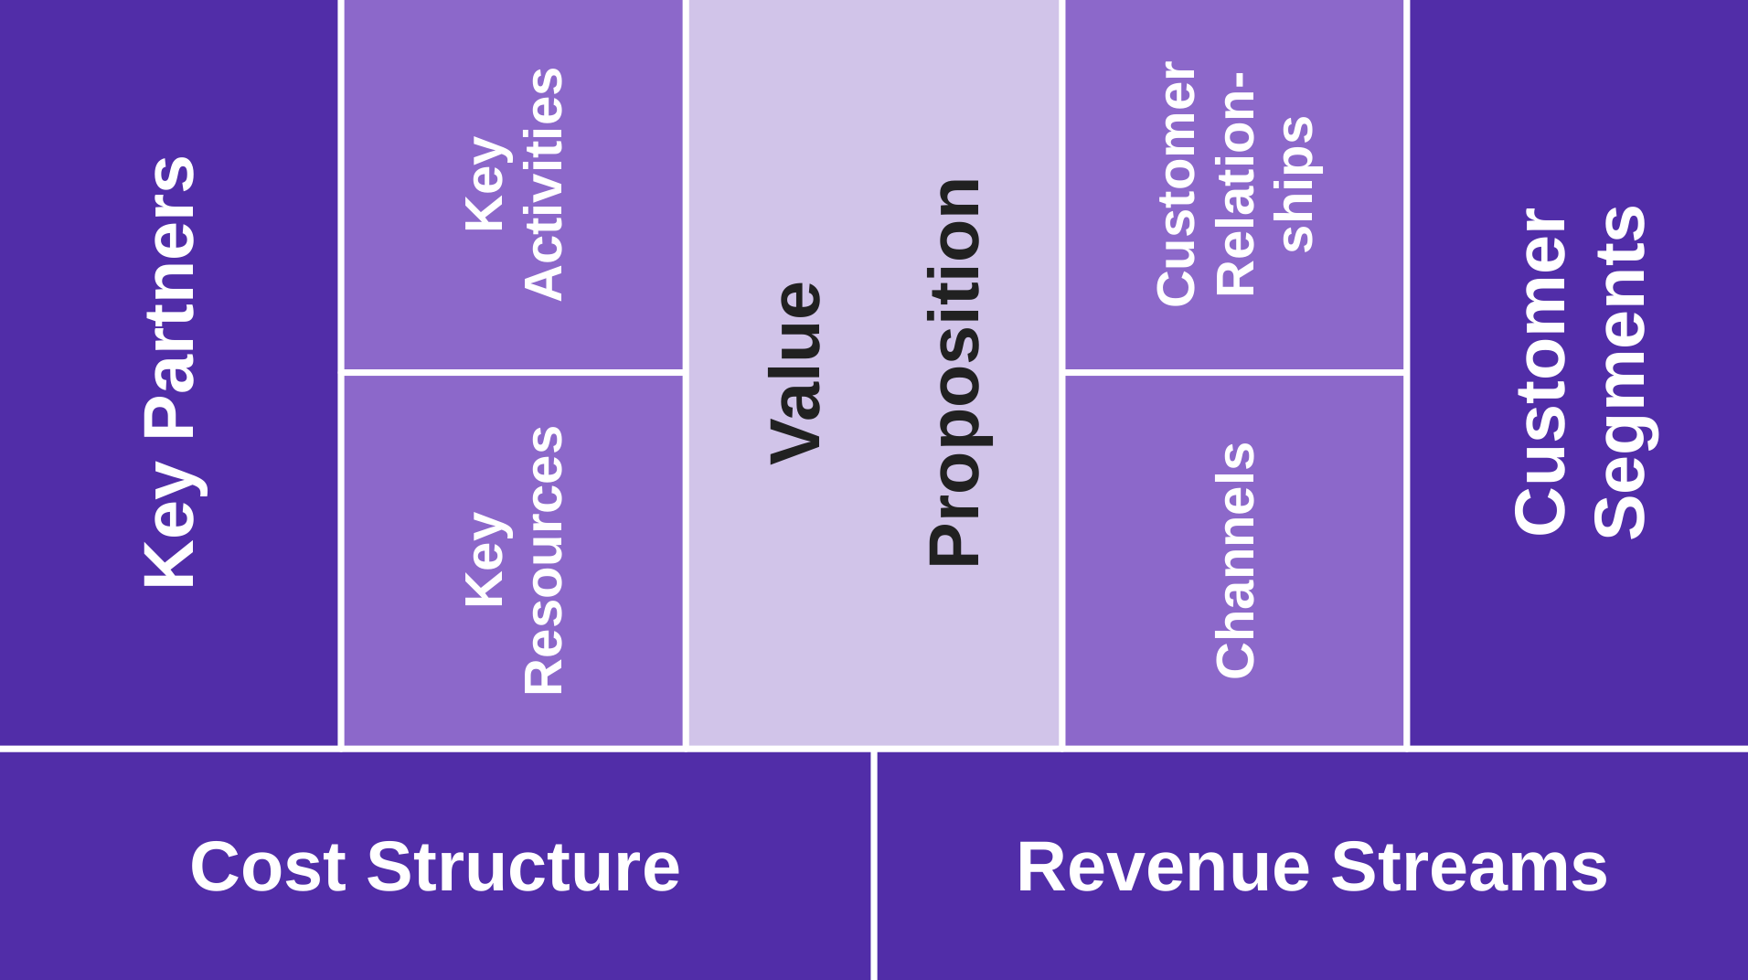
The Business Model Canvas
Operations and
production
Revenue
generation

Slide 3
2
Key
Activities
3
1
1
Customer Relationships
3
Key Partners
Customer
Segments
Value
Proposition
Key Re-sources
2
Channels
2
Cost Structure
Revenue Streams
3
1

Slide 4
Components of the Business Model Canvas
Customer segments
Value proposition
Revenue sources

Slide 5
Components of the Business Model Canvas
Channels
Key partners
Key resources

Slide 6
Components of the Business Model Canvas
Customer relationships
Key activities
Cost structure

Slide 7
Thank you! Questions?
dirk.riehle@fau.de – http://osr.cs.fau.de
dirk@riehle.org – http://dirkriehle.com – @dirkriehle
DR

Slide 8
Credits and License
Original version
  © 2020 Dirk Riehle, some rights reserved
  Licensed under Creative Commons Attribution 4.0 International License
Contributions
  None yet

